Slide 1
Superuser Mobility and DMO Demo

Slide 2
DMO and Mobility
Agenda
Introduction to team
Introduction to DMO
DMO multistep order demo
Introduction to Haiku & Canto
Mobility Demo
Discussion
Notes:
The goal is for the educators to be proficient in DMO in order to train and support providers in each of the Connect Care waves.

Slide 3
What is Dragon Medical One (DMO)?
DMO and Mobility
DMO is the tool that AHS will be using for front-end speech recognition.
It allows providers to document directly into Connect Care in real time using their voice.
DMO resides in the cloud and can be used anywhere there is a connection to the internet and Connect Care.
DMO is ready to use immediately without extensive training to create your voice profile.
Dictation can be done using a variety of input devices.
Notes:
What is Dragon Medical One
It is front end speech recognition
Will allow providers to document directly into Epic – think of it as a keyboard and mouse replacement
Resides in the cloud and can be used anywhere there is a connection to the internet and access to Epic. DMO is launched directly from within Epic
This is the most robust dragon tool, out of the box it is almost 100% accurate which is a huge step up from what we have previously seen.
5. Dictation can be done using a variety of input devices.

Slide 4
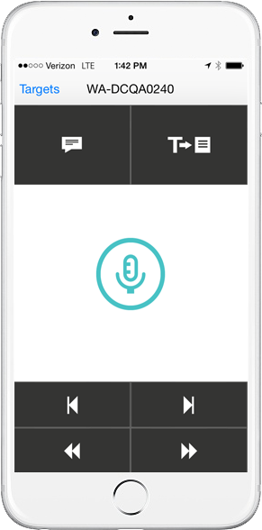
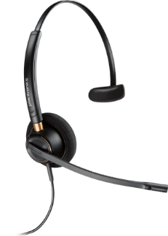
Optional input devices
DMO and Mobility
Secure Input Options
PowerMic Mobile
Turns your (android / iOS) device into a secure wireless microphone allowing you to dictate at any workstation.
USB microphone or headset connected to your computer.
Notes:
These are the input options
AHS has endorsed that PowerMic Mobile will be our primary input device.
It’s an app that is download onto your android or iOS device and when you log in it automatically pairs with your Epic session and allows you to use your phone to dictate.
There are also some areas that don’t lend themselves to the use of PMM so will be looking at the use of USB microphones or headsets and these will be tethered to devices.
Only available based on a business case. An Emergency Department may not lend itself well to powermic mobile but may be the perfect environment for a tethered microphone.
Bullet 2: USB microphones with noise cancelling features are ideal for noisy areas such as Emergency Departments Optional input devices are the responsibility of the end user for securing their own devices.

Slide 5
Dragon Embedded in Haiku and Canto
DMO and Mobility
Using DMO with iPhone or iPad
Epic’s Haiku and Canto allow for access to Connect Care and the ability to dictate notes and place orders using your iPhone or iPad.

Slide 6
DMO and Mobility
Where Will Providers Learn About DMO?
Introduction to DMO will be provided during Connect Care Basic Training.
Basic DMO Training will occur during Connect Care Personalization.
Advanced DMO Training will occur during Connect Care Optimization.
Additional training, learning links and support will be available following optimization for users who want to maximize their use of DMO.
Notes:
This shows where providers will learn about DMO
DMO will be introduced during Epic Basic Training through CMIO training tracks
Users will be given a general introduction and overview and provided with link to view eLearning videos,
Links will be provided for users wanting to explore more.
Basic DMO Training will occur during Epic Personalization.
Users will learn how to download PowerMic Mobile, some best practices for using DMO and some basic voice commands.
Advanced DMO Training will occur during Epic Optimization.
Users will learn how to program basic and step-by-step commands, also known as proficiency features.
Additional training and support will be available following optimization for users who want to maximize their use of DMO.

Slide 7
DMO Demo

Slide 8
DMO and Mobility
Resources
Connect Care Manual
https://sites.google.com/view/cc-manual/dictation
DST home
https://insite.albertahealthservices.ca/him/Page4272.aspx
Voice Commands
https://galaxy.epic.com/? - Browse/page=1!68!600!100039441
Key Board Shortcuts
https://galaxy.epic.com/?#Browse/page=8400!54!483!4320637&from=Favorites

Slide 9
For more information on
Speech Recognition
in Connect Care
speechrecognition@ahs.ca

Slide 10
What are Haiku and Canto
DMO and Mobility
Haiku is a phone-based app usable on Android and Apple phones
Canto is a tablet-based app usable with iPads
Intuitive – no training recommended
Will need to enroll in Work Space 1
Quickstart guides
https://sites.google.com/view/cc-manual/Mobility

Slide 11
Epic User Web

Slide 12
Epic User Web

Slide 13
Epic User Web

Slide 14
Epic User Web

Slide 15
Epic User Web

Slide 16
Thank You!

